Slide 1


MajorProject
Title: CampusCompute: Campus-Aware Cloud Resource Pooling System
Presented by:
Krishna Bisht – R2142231009
Kuldeep Chaudhary-Name
Rishu Raj-Name
Daksh Mehrotra-Name
Mentored By: Dr Hanief Wani

Slide 2
Content
Introduction
Literature Review
Objectives
Methodology
References

Slide 3
Introduction
Purpose
College computer laboratories represent a significant capital investment, yet they experience
dramatic utilization patterns. During scheduled lab sessions, machines operate at 80-100%
capacity, while outside these hours—evenings, weekends, and holidays—utilization drops to
as low as 5-20%. This represents substantial wasted computing capacity that could benefit
students requiring computational resources for coursework, projects, and research.
The purpose of CampusCompute is to transform underutilized campus lab computers into a
shared cloud computing platform. By intelligently pooling idle computational resources and
providing on-demand access through isolated Docker containers, the system maximizes the
return on investment of existing infrastructure while democratizing access to computing
resources.
The project addresses three key challenges:
Resource Underutilization: Converting idle lab machines into productive assets during
off-peak hours.

Slide 4
Introduction
Access Inequality: Providing students without personal high-performance computers equal
access to computational resources.
Academic Integration: Respecting institutional schedules and lab reservations while optimizing resource allocation.
The motivation for this project stems from the observation that educational institutions
maintain expensive computing infrastructure that remains idle for significant periods, while
students often lack adequate computing resources for demanding academic work.
CampusCompute bridges this gap through a campus-aware resource scheduling system.

Slide 5
Literature Review
SWOT analysis
Strengths:
Novel academic-aware scheduling algorithm
Utilizes existing infrastructure without additional hardware costs
Browser-based access requires no client-side software installation
Strong isolation through Docker containerization
Scalable architecture supporting hundreds of devices
Privacy-preserving design protecting student data
Weaknesses:
Dependency on lab computer availability and network connectivity
Requires Docker installation and agent deployment on all participating machines
Limited to institutions with existing computer lab infrastructure
Resource availability fluctuates with academic schedules
Browser terminal performance inferior to native SSH clients

Slide 6
Literature Review
SWOT analysis
Opportunities:
Expansion to multiple campuses within a university system
Integration with learning management systems (Canvas, Moodle)
Support for GPU-accelerated workloads for AI/ML courses
Partnership with cloud providers for hybrid resource pooling
Commercial licensing to other educational institutions
Research opportunities in campus computing optimization
Threats:
Commercial cloud providers offering education discounts (AWS Educate, Azure for Students)
Security incidents could undermine institutional confidence
Budget constraints limiting infrastructure maintenance
Resistance from IT departments regarding security and management overhead
Rapid technology changes requiring continuous system updates

Slide 7
Objective
Develop a three-layer architecture: web interface, central broker, and distributed agents
Implement secure authentication and role-based access control
Create an adaptive scheduler that respects academic schedules and lab reservations
Provide browser-based terminal access to containerized environments
Enforce resource quotas and usage policies
Monitor system health and resource utilization
Ensure container isolation and security

Slide 8
Methodology
Steps
1. User Authentication
User logs in using university credentials.
JWT is issued.
Role and quota are verified.
2. Resource Request
User requests CPU, RAM and duration for a container.
3. Device Filtering
Remove offline/unhealthy devices.
Check CPU and RAM availability.
Check lab reservations.
4. Device Scoring
Calculate scheduling score using:
  CPU availability
  RAM availability
  Current load
  Reservation proximity
  Reliability
5. Device Selection
Select the device with the highest score.
6. Container Provisioning
Broker sends a command to the selected agent.
Agent creates the Docker container.
7. User Access
User accesses the container through the browser terminal.
8. Monitoring
Agents send heartbeats every 10 seconds.
Resource usage is continuously monitored.

Slide 9
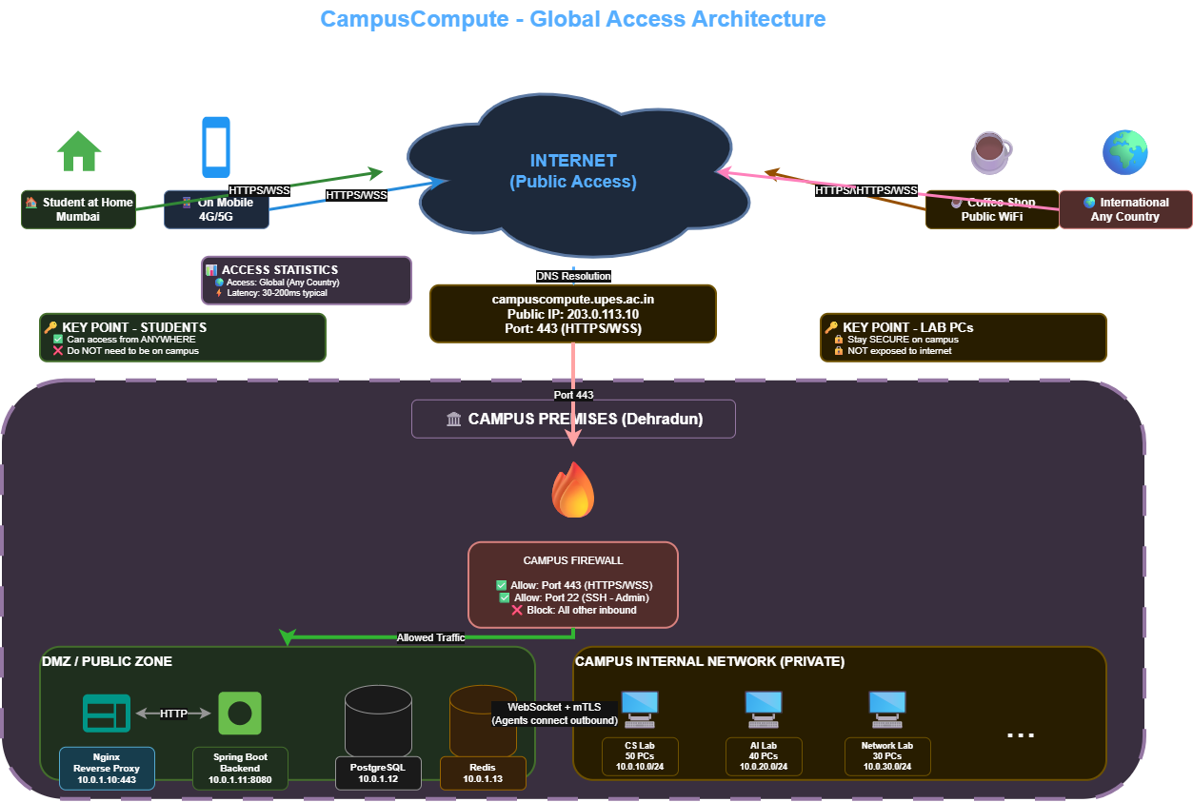
Methodology

Slide 10
Reference
Merkel, D. (2014). Docker: Lightweight Linux Containers for Consistent Development and Deployment. Linux Journal.
Schwarzkopf, M., et al. (2013). Omega: Flexible, Scalable Schedulers for Large Compute Clusters. EuroSys.
Burns, B., et al. (2016). Borg, Omega, and Kubernetes. ACM Queue, 14(1).
Docker Documentation.
Docker Containerization and Engine Documentation
Spring Boot Reference Documentation.
React Documentation.
PostgreSQL Documentation.
Kubernetes Documentation.
RFC 6455 — WebSocket Protocol.
RFC 7519 — JSON Web Token (JWT).

Slide 11
Thank You

